Slide 1
Week 2: What Motivates You?
Dr. Terrence Sejnowski

Slide 2
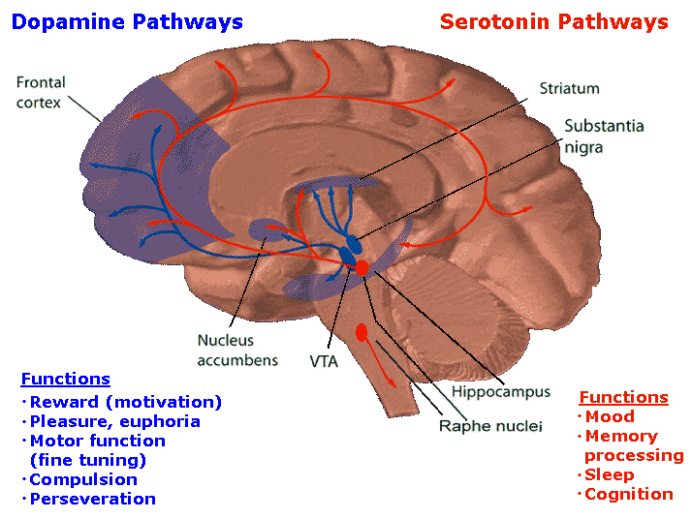

Slide 3
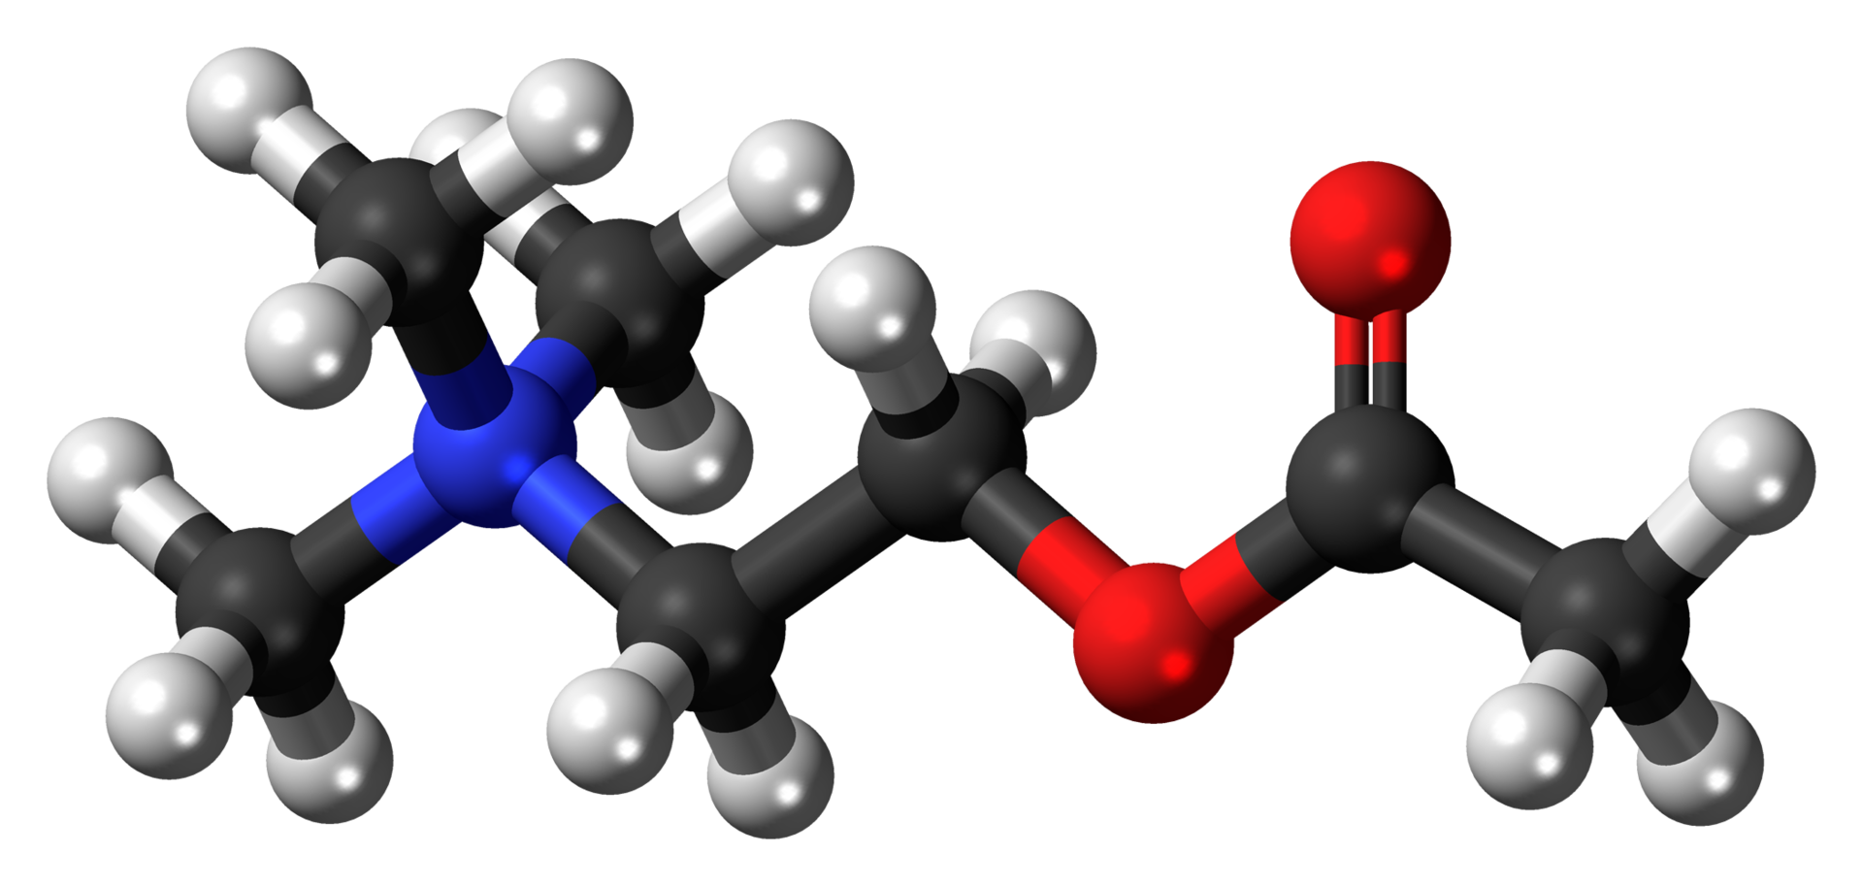
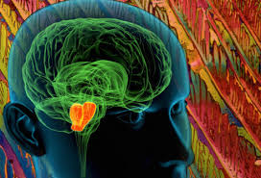
Acetylcholine, a chemical produced by acetylcholine neurons

Slide 4
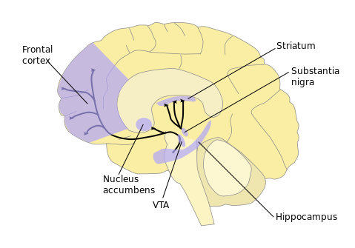
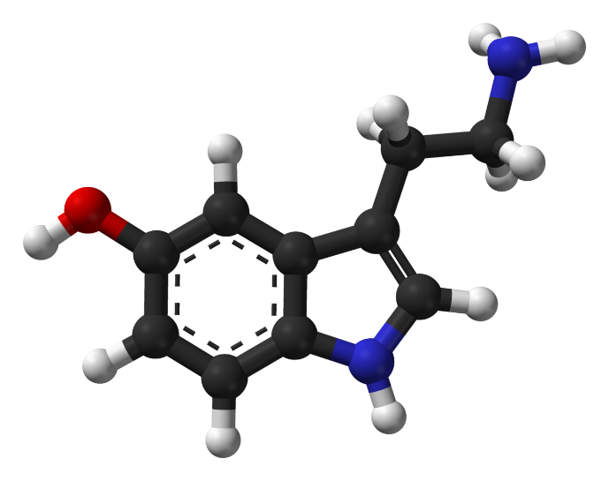
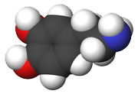
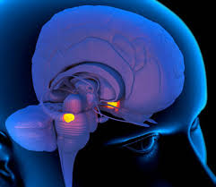
Dopamine molecule
Serotonin molecule
Dopamine signaling pathways

Slide 5
Relevant Readings
Inda MC, Muravieva EV, Alberini CM. “Memory retrieval and the passage of time: from reconsolidation and strengthening to extinction.” Journal of Neuroscience 2011 Feb 2; 31(5):1635-43. PMID: 21289172.
Han X, Chen M, Wang F, Windrem M, Wang S, Shanz S, Xu Q, Oberheim NA, Bekar L, Betstadt S, Silva AJ, Takano T, Goldman SA, Nedergaard M. “Forebrain engraftment by human glial progenitor cells enhances synaptic plasticity and learning in adult mice.” Cell Stem Cell. 2013 Mar 7;12(3):342-53.
www.brainfacts.org
Image Credits
Dopamine and serotonin pathways, National Institutes of Health, http://en.wikipedia.org/wiki/File:Dopamineseratonin.png
Ball-and-stick model of the acetylcholine cation, a neurotransmitter in many organisms including humans. The nitrogen atom has a positive charge. Black: Carbon, C; White: Hydrogen, H ; Red: Oxygen, O ; Blue: Nitrogen, N; Work produced by Jynto. http://en.wikipedia.org/wiki/Acetylcholine#mediaviewer/File:Acetylcholine-cation-3D-balls.png
Dopamine -3d-CPK, Sbrools, http://en.wikipedia.org/wiki/Dopamine#mediaviewer/File:Dopamine-3d-CPK.png
Dopamine pathways, NIDA http://en.wikipedia.org/wiki/Dopamine#mediaviewer/File:Dopamine_pathways.svg
Ball-and-stick model of the serotonin molecule, by Ben Mills, http://en.wikipedia.org/wiki/Seratonin#mediaviewer/File:Serotonin-Spartan-HF-based-on-xtal-3D-balls-web.png

